Slide 1
OptCtrlPoints: Finding the Optimal Control Points for Biharmonic 3D Shape Deformation
Pacific Graphics 2023 (Full Paper)
Kunho Kim^{*1,} Mikaela Angelina Uy^{*2}, Despoina Paschalidou²,
Alec Jacobson³, Leonidas Guibas², Minhyuk Sung¹
¹KAIST ²Stanford University ³University of Toronto
^{* denotes equal contribution.}
Notes:
Hello, I’m Kunho Kim from KAIST. And I’m a master student supervised by Professor Minhyuk Sung. Today, we introduce OptCtrlPoints, Finding the Optimal Control Points for Biharmonic 3D Shape Deformation.
As you can see in the teaser image, our method can find the optimal control points that generate more plausible shape variations through deformation.

Slide 2
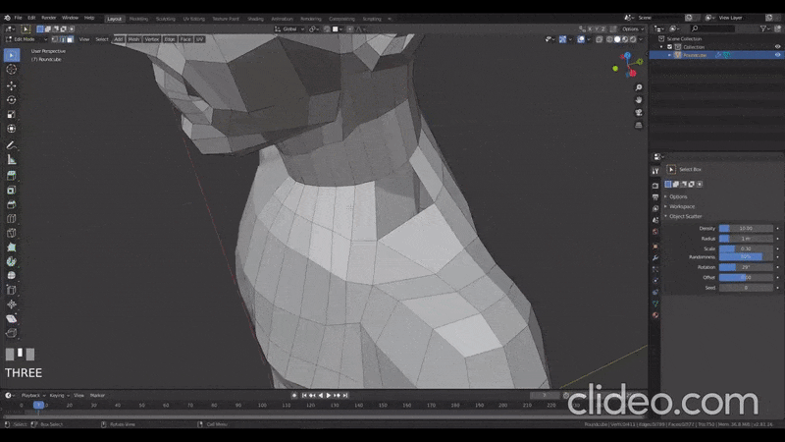
Motivation
3D Modeling is a time-consuming task.
(X4 Speed up) Modeling a character basemesh in Blender
https://www.youtube.com/watch?v=WlaMfIgS2ns
Notes:
Geometric modeling is an essential for creating virtual 3D contents and designing real objects.
Yet, creating 3D modeling remains as a tedious and time-consuming task requiring specialized expertise.

Slide 3
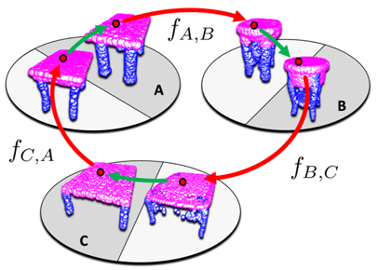
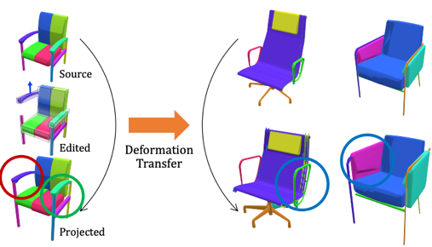
Motivation
Shape deformation is an important technique that enables producing plausible variations of existing high-quality 3D assets.
Unsupervised Cycle-consistent Deformation for Shape Matching [Groueix et al., 2021]
DefromSyncNet
[Sung et al., 2020]
Notes:
Shape deformation is thus an important technique that enables producing plausible variations of existing high-quality, artist-generated 3D assets.
Due to its importance and broad impact, shape deformation has been extensively studied by the geometry processing community.

Slide 4
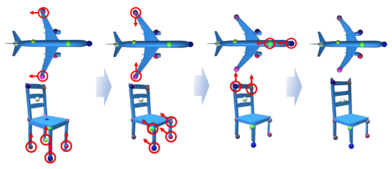
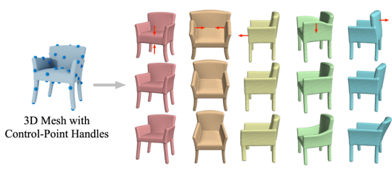
Motivation
Handle-based deformation parameterizes smooth deformations with a low degree of freedom.
KeyPointDeformer [Jakab et al., 2021]
DeepMetaHandles [Liu et al., 2021]
Neural Shape Deformation Priors
[Tang et al., 2022]
Notes:
Specifically, handle-based deformation allow users to edit shapes using a set of deformation handles which are intuitive and procedural parameters directly coming from the 3D models.
It parameterizes smooth deformations with a low degree of freedom.

Slide 5
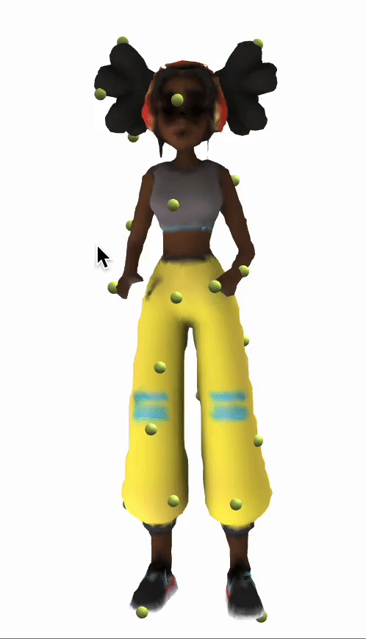
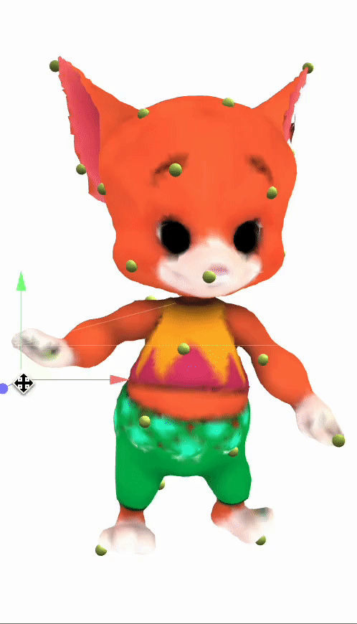
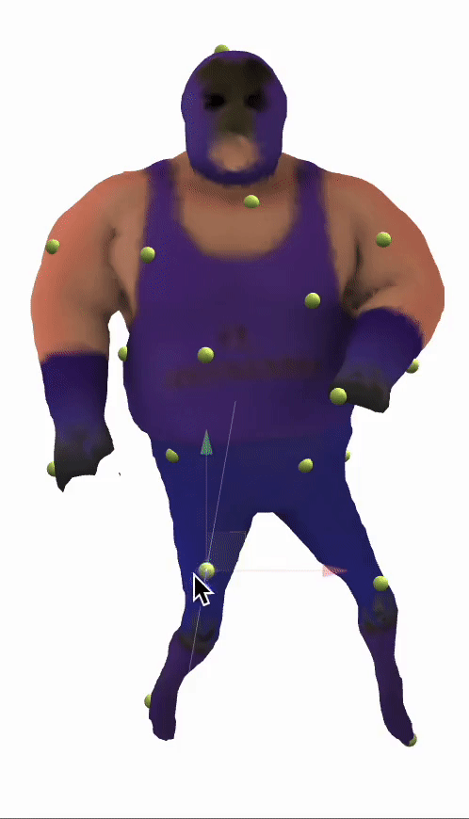
Motivation
Users can edit the mesh by adjusting the positions of the handles to achieve the desired deformed shape.
Pop-Out Motion [Lee et al., 2022]
Notes:
With these handles, Users can edit the mesh by adjusting the positions of handles to achieve the desired deformed shape.

Slide 6
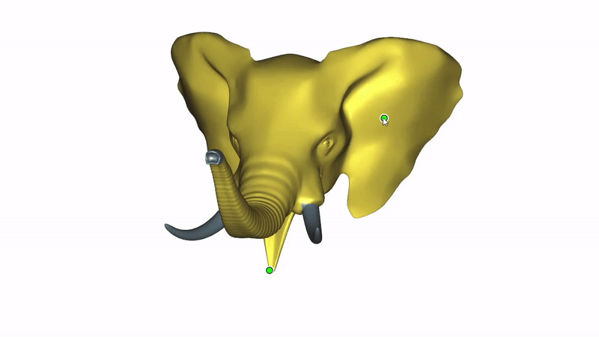
Motivation
Control points
($+$) Provide a high level of flexibility that cannot be achieved with cages or skeletons.
Linear Subspace Design for Real-Time Shape Deformation [Wang et al., 2015]
Notes:
Different types of handles have different advantages. There are three types of handles, cage, skeleton and control points. Among them, we focused on the control points.
The control points can provide loose and smooth control that cannot be achieved with cages or skeletons.

Slide 7
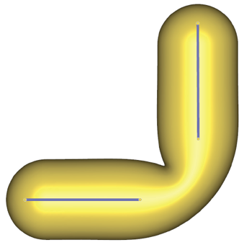
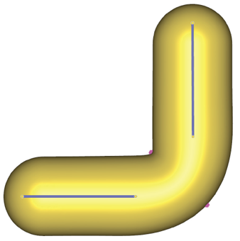
Motivation
Control points
($+$) Provide a high level of flexibility that cannot be achieved with cages or skeletons.
($−$) Crucial to place the control points to the best locations.
Linear Subspace Design for Real-Time Shape Deformation [Wang et al., 2015]
Notes:
However, the control point based deformation is heavily influenced by the position of the control points.
As you can see, the left space suffers from linear artifacts,
(enter)
but these disappear after adding two auxiliary control points.
Since the deformation result is sensitive to the position of control points, placing the control points to the best positions is important.

Slide 8
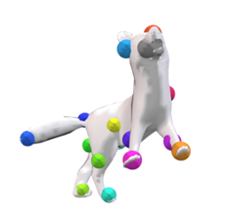
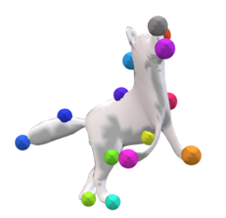
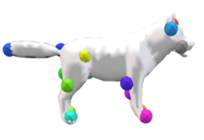
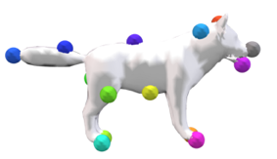
Challenge
If the control points are located in inappropriate positions, it can lead to implausible deformed shapes.
Template
Deformed Template
Notes:
Let me show you a more detailed example. If the control points are located in inappropriate positions, it can lead to implausible deformed shapes.
(enter)
Conversely, well-placed control points generate plausible deformed shapes.

Slide 9
Goal
Find the optimal $K$-subset of the $N$ source vertices as control points, which can best fit all the target shapes with their corresponding positions in the target in a data-driven manner.
Template
Target
Deformed Template
Notes:
We thus aim to find the optimal K-subset of the N source vertices as control points with target-driven deformation.
The optimal set of control points means that it best fit all the target shapes with their corresponding positions in the target.

Slide 10
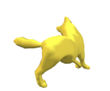
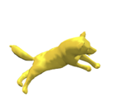
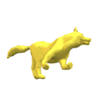
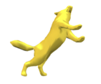
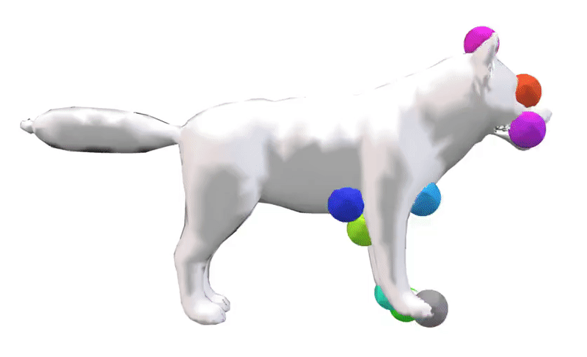
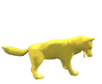
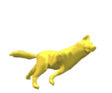
Problem Definition
Input
A template mesh.
Multiple target meshes (variants of the template).
Correspondence between the template and target meshes.
Output
A subset of vertices as the control points that minimize the average fitting distance between the deformed templates and target meshes.
Template
Control points
Multiple targets
Notes:
To achieve this goal, we assume that
(enter)
a template mesh,
(enter)
multiple target meshes and
(enter)
correspondence between them are given.
(enter)
Using these inputs, we want to find the optimal control points that minimize the average fitting distance between the deformed meshes and target meshes.

Slide 11
Preliminaries
Notes:
Now, let me explain the preliminaries.

Slide 12
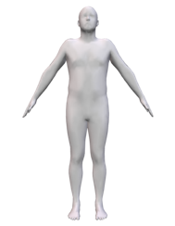
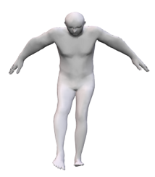
Notation
The position of template vertices $X∈ ℝ^{N×3}$
$$X∈ ℝ^{N×3}$$
Template vertices
$$V∈ ℝ^{N×3}$$
Deformed vertices
Notes:
Before we get into the preliminaries, we will explain the notation.
X denotes the position of template vertices.

Slide 13
Notation
The position of template vertices $X∈ ℝ^{N×3}$
The position of deformed vertices $V∈ ℝ^{N×3}$
$$X∈ ℝ^{N×3}$$
Template vertices
$$V∈ ℝ^{N×3}$$
Deformed vertices
Notes:
The deformed vertices will be denoted as V.

Slide 14
Notation
The binary selector matrix $S$ indicates the vertex indices of the control points in the template mesh.
The position of template vertices $X∈ ℝ^{N×3}$
The binary selector matrix $S∈ ℝ^{K×N}$
The position of deformed vertices $V∈ ℝ^{N×3}$
$$X∈ ℝ^{N×3}$$
Template vertices
$$V∈ ℝ^{N×3}$$
Deformed vertices
Notes:
The binary selector matrix S indicates the vertex indices of the control points in the template mesh.

Slide 15
Notation
$T$ is the complementary selector matrix of $S$ indicating the vertex indices of the template mesh that are not selected as the control points.
The position of template vertices $X∈ ℝ^{N×3}$
The binary selector matrix $S∈ ℝ^{K×N}$
The position of deformed vertices $V∈ ℝ^{N×3}$
The complementary selector matrix $T∈ ℝ^{(N−K)×N}$
$$X∈ ℝ^{N×3}$$
Template vertices
$$V∈ ℝ^{N×3}$$
Deformed vertices
Notes:
T is the complementary selector matrix of S indicating the vertex indices of the template mesh that are not selected as the control points.

Slide 16
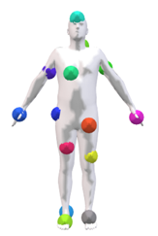
Notation
The positions of the control points $C=SX$.
The set of control points is a subset of the template vertices.
The position of template vertices $X∈ ℝ^{N×3}$
The binary selector matrix $S∈ ℝ^{K×N}$
The position of deformed vertices $V∈ ℝ^{N×3}$
The complementary selector matrix $T∈ ℝ^{(N−K)×N}$
The position of control points $C∈ ℝ^{K×3}$
$$C∈ ℝ^{K×3}$$
Control points, $SX=C$
$$V∈ ℝ^{N×3}$$
Deformed vertices
Notes:
C denotes the positions of the control points. We can calculate C by multiplying S and X. Note that the set of control points is a subset of the template vertices.

Slide 17
Notation
The bilaplacian matrix is a positive semi-definite matrix used to measure the fairness of template shape.
The position of template vertices $X∈ ℝ^{N×3}$
The binary selector matrix $S∈ ℝ^{K×N}$
The position of deformed vertices $V∈ ℝ^{N×3}$
The complementary selector matrix $T∈ ℝ^{(N−K)×N}$
The position of control points $C∈ ℝ^{K×3}$
The bilaplacian matrix $A∈ ℝ^{N×N}$
$$X∈ ℝ^{N×3}$$
Template vertices
$$V∈ ℝ^{N×3}$$
Deformed vertices
Notes:
A is the bilaplacian matrix, which is a positive semi-definite matrix used to measure the fairness of X.
With this notation,

Slide 18
Preliminaries
The following optimization finds the positions of the deformed vertices $V$ that minimize squared Laplacian energy when the positions of the selected control points are fixed to be $C$.
$$V=\underset{X∈ℝ^{N×3}}{argmin}{\frac{1}{2}trace(X^{⊤}AX)}$$
$$subject to SX=C$$
Solution: $V=WC$
where $W\left(S;A\right)=S^{⊤}−T^{⊤}{\left(TAT^{⊤}\right)}^{−1}TAS^{⊤}$
The position of template vertices $X∈ ℝ^{N×3}$
The position of deformed vertices $V∈ ℝ^{N×3}$
The binary selector matrix $S∈ ℝ^{K×N}$
The complementary selector matrix $T∈ ℝ^{(N−K)×N}$
The position of control points $C∈ ℝ^{K×3}$
Linear Subspace Design for Real-Time Shape Deformation [Wang et al., 2015]
The bilaplacian matrix $A∈ ℝ^{N×N}$
Notes:
we explain the details about the closed-form formulation of the biharmonic coordinate deformation function.
This optimization finds the positions of the deformed vertices $V$ that minimize squared Laplacian energy when the positions of the selected control points are fixed to be $C$.
(enter)
Biharmonic coordinates is defined as the closed-form formulation of this optimization, namely V equals WC. Here, W called biharmonic weights is derived from the solution of the above optimization.

Slide 19
Challenges
1. Long computation time of $W(S;A)$due to varying control points.
$$W\left(S;A\right)=S^{⊤}−T^{⊤}{\left(TAT^{⊤}\right)}^{−1}TAS^{⊤}$$
When the control points are fixed, the deformations can be computed quickly by prefactorizing $TAT^{⊤}∈ℝ^{(N−K)×(N−K)}$.
${TAT}^{⊤}$
Prefactorize
only once!
The position of template vertices $X∈ ℝ^{N×3}$
The position of deformed vertices $V∈ ℝ^{N×3}$
The binary selector matrix $S∈ ℝ^{K×N}$
The complementary selector matrix $T∈ ℝ^{(N−K)×N}$
The position of control points $C∈ ℝ^{K×3}$
The bilaplacian matrix $A∈ ℝ^{N×N}$
$$N−K$$
Notes:
When the control points and resulting biharmonic weights are fixed, we calculate biharmonic weight only once.
Note that, the deformations can be computed quickly by prefactorizing TAT transpose.
(enter)
That means we prefactorize matrix only once.

Slide 20
Challenges
1. Long computation time of $W(S;A)$due to varying control points.
$$W\left(S;A\right)=S^{⊤}−T^{⊤}{\left(TAT^{⊤}\right)}^{−1}TAS^{⊤}$$
Since we want to find the optimal control points, we need to vary the control points. When computing deformations with different sets of control points, it is not feasible to leverage the prefactorization since the complementary selector matrix T varies.
${TAT}^{⊤}$
${TAT}^{⊤}$
${TAT}^{⊤}$
Prefactorize
multiple times
The position of template vertices $X∈ ℝ^{N×3}$
The position of deformed vertices $V∈ ℝ^{N×3}$
The binary selector matrix $S∈ ℝ^{K×N}$
The complementary selector matrix $T∈ ℝ^{(N−K)×N}$
The position of control points $C∈ ℝ^{K×3}$
The bilaplacian matrix $A∈ ℝ^{N×N}$
$$N−K$$
Notes:
However, Since we want to find the optimal control points, we need to vary the control points. when computing deformations with different sets of control points, it is not feasible to leverage the prefactorization since the complementary selector matrix T varies.
(enter)
That means we need to calculate its prefactorization multiple times.
Here, TAT transpose is too large matrix to calculate its prefactorization multiple times.

Slide 21
Challenges
2. NP-complete combinatorial optimization problem.
Identifying the optimal $K$-subset from a pool of $N$ elements is an NP-complete combinatorial optimization problem.
One possible solution is the exhaustive search that tests all k-subsets.
Exhaustive search $\left({N \atop K}\right)$ is impractical due to the typically high number of vertices.
Notes:
Another challenge is that identifying the optimal $K$-subset from a pool of $N$ elements is an NP-complete combinatorial optimization problem.
(enter)
One possible solution is the exhaustive search that tests all k-subsets.
(enter)
However, exhaustive search is impractical due to the typically high number of vertices.

Slide 22
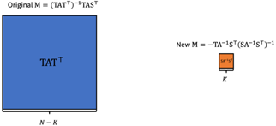
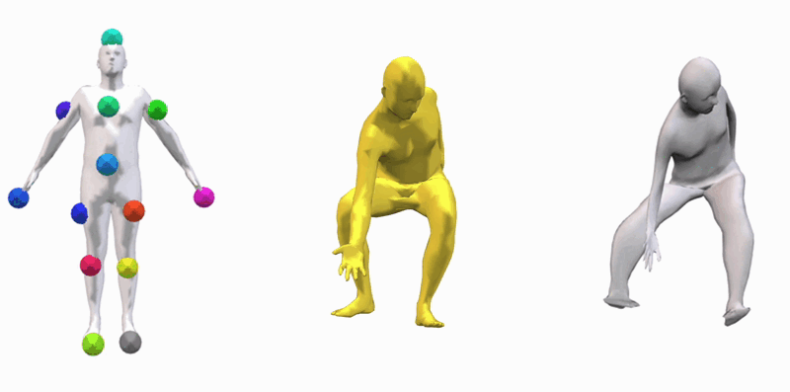
Challenges
1. Long computation time of $W(S;A)$due to varying control points.
When control points vary, the calculation of $W\left(S;A\right)$ becomes a bottleneck.
→ We propose a reformulation of $W(S;A)$that reduces computation time.
2. NP-complete combinatorial optimization problem.
Exhaustive search $𝒪\left(N^{K}\right)$ is infeasible due to the high number of vertices.
→ We propose an efficient search algorithm.
Notes:
So, there are two main challenges to achieve the goal.
(enter)
To address these challenge, first, we introduce a reformulation of biharmonic weight that yields the same biharmonic weight matrix W while solving a linear system on a much smaller scale.
(enter)
We also propose an efficient search algorithm that reduces the time complexity, while effectively finding nearly optimal solutions.

Slide 23
Method
Notes:
[6:10]
Now, let me explain our approach in details.

Slide 24
Outline
1. Reformulation of $W\left(S;A\right)$
2. Level-of-Detail Search Algorithm
Notes:
I’ll describe our reformulation of biharmonic weight, and level of detail control point search algorithm.

Slide 25
Outline
1. Reformulation of $W\left(S;A\right)$
2. Level-of-Detail Search Algorithm
Notes:
To address the first challenge, we introduce a reformulation of biharmonic weights.

Slide 26
Reformulation of $W\left(S;A\right)$
Let $M$ denote the linear system in $W\left(S;A\right)=S^{⊤}−T^{⊤}{\left(TAT^{⊤}\right)}^{−1}TAS^{⊤}$:
$$M={\left(TAT^{⊤}\right)}^{−1}TAS^{⊤}$$
With a derivation involving the Schur’s complement, we can rewrite $M$:
$M=−{TA}^{−1}S^{⊤}{\left(SA^{−1}S^{⊤}\right)}^{−1}$,
By replacing $M$ in the initial $W\left(S;A\right)$, we get the following reformulation:
$$W\left(S;A\right)=S^{⊤}+T^{⊤}\left({TA}^{−1}S^{⊤}{\left(SA^{−1}S^{⊤}\right)}^{−1}\right)$$
The position of template vertices $X∈ ℝ^{N×3}$
The position of deformed vertices $V∈ ℝ^{N×3}$
The binary selector matrix $S∈ ℝ^{K×N}$
The complementary selector matrix $T∈ ℝ^{(N−K)×N}$
The position of control points $C∈ ℝ^{K×3}$
The bilaplacian matrix $A∈ ℝ^{N×N}$
Notes:
Let M denote the linear system in the original biharmonic weight W(S;A).
(enter)
With a derivation involving the Schur complement, we can rewrite M like this.
(enter)
By replacing $M$ in the initial biharmonic weight, we get the following reformulation.

Slide 27
Reformulation of $W\left(S;A\right)$
Original $W\left(S;A\right)=S^{⊤}−T^{⊤}{\left(TAT^{⊤}\right)}^{−1}TAS^{⊤}$
Reformulation of $W\left(S;A\right)=S^{⊤}+T^{⊤}\left({TA}^{−1}S^{⊤}{\left(SA^{−1}S^{⊤}\right)}^{−1}\right)$
Original $M={\left(TAT^{⊤}\right)}^{−1}TAS^{⊤}$
${TAT}^{⊤}$
New $M=−{TA}^{−1}S^{⊤}{\left(SA^{−1}S^{⊤}\right)}^{−1}$
$$N−K$$
$$K$$
$${{SA}^{−1}S}^{⊤}$$
$$K$$
$$N−K$$
Notes:
Now, we compare the difference between the original M and new M by our reformulation.
Here, SA inverse S transpose is way smaller than TAT transpose.

Slide 28
Reformulation of $W\left(S;A\right)$
If $N=5,000$ (the number of the vertices) and $K=16$ (the number of the control points), we can see that the difference is huge.
Original $M={\left(TAT^{⊤}\right)}^{−1}TAS^{⊤}$
${TAT}^{⊤}$
New $M=−{TA}^{−1}S^{⊤}{\left(SA^{−1}S^{⊤}\right)}^{−1}$
4,982
16
$${{SA}^{−1}S}^{⊤}$$
16
4,982
Notes:
If we set the number of vertices, N to five thousand and the number of control points, K to sixteen, we can see that the difference is huge.

Slide 29
Reformulation of $W\left(S;A\right)$
If $N=5,000$ (the number of the vertices) and $K=16$ (the number of the control points), we can see that the difference is huge.
Original $M={\left(TAT^{⊤}\right)}^{−1}TAS^{⊤}$
${4,982}^{2}$ $$=24,820,324$$
New $M=−{TA}^{−1}S^{⊤}{\left(SA^{−1}S^{⊤}\right)}^{−1}$
4,982
16
$${16}^{2} \\ =256$$
16
4,982
Notes:
The original M has over twenty million elements, while the new M has only two hundred fifty six elements.
This demonstrates that our reformulation significantly reduces the time required for prefactorization.

Slide 30
Handling the singularity of $A$
Since the bilaplacian matrix $A$ is non-invertible, we cannot directly apply our reformulation. Thus, we use either:
(1) Shaving-off technique.
(2) Regularization for $A$.
Notes:
However, since the bilaplacian matrix is positive semi-definite and non-invertible, we can apply some techniques, handling the singularity of the Bilaplacian matrix A. Thus, we can use shaving-off technique or regularization for A.

Slide 31
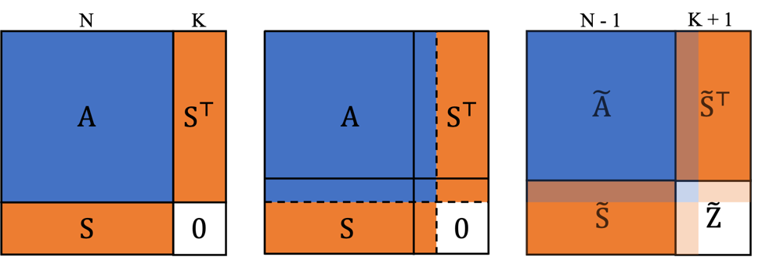
(1) Shaving-off technique
We can apply shaving-off technique to handle the singularity of $A$.
$$\tilde{W}\left(S;A\right)={\tilde{S}}^{⊤}+{\tilde{T}}^{⊤}\left({\tilde{T}A}^{−1}{\tilde{S}}^{⊤}{\left(\tilde{S}A^{−1}{\tilde{S}}^{⊤}−\tilde{Z}\right)}^{−1}\right)$$
Notes:
To handle the singularity of the Bilaplacian matrix A, we can apply the shaving-off technique.
(enter)
With this technique, the final biharmonic weight is altered slightly. You can find more details in our paper.

Slide 32
(2) Regularization of $A$
Or, we can regularize $A$ by adding a small-weighted identity matrix $(A+εI)$.
Reformulation of $W\left(S;A+εI\right)$
${T(A+εI)T}^{⊤}$
$${{S(A+εI)}^{−1}S}^{⊤}$$
$$K$$
$$N−K$$
Notes:
Instead of shaving-off technique, we regularize the Bilaplacian matrix A by adding a small-weighted identity matrix, approximating the solution while achieving numerical stability. We choose this method for the experiments.

Slide 33
Outline
1. Reformulation of $W\left(S;A\right)$
2. Level-of-Detail Search Algorithm
Notes:
Now, let me explain our level of detail control points search algorithm.

Slide 34
Challenges
1. Long computation time of $W(S;A)$due to varying control points.
When control points vary, the calculation of $W\left(S;A\right)$ becomes a bottleneck.
→ We propose a reformulation of $W(S;A)$that reduces computation time.
2. NP-complete combinatorial optimization problem.
Exhaustive search $𝒪\left(N^{K}\right)$ is infeasible due to the high number of vertices.
Notes:
Although the computation of the biharmonic weight matrix becomes faster with our reformulation, the exhaustive search is infeasible due to the typically high number of vertices.
To address the second challenge, we propose an efficient search algorithm that reduces the time complexity.

Slide 35
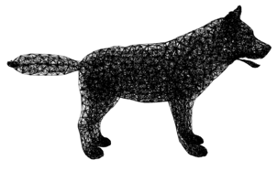
Mesh Partitioning
Geodesic FPS
over surface
Nearest neighbor
with graph distance
Source Volume Mesh
FPS points
$K$ partitions
Notes:
First, we construct the partitions of mesh for effective search.
(enter)
We utilize geodesic farthest point sampling over surface of the mesh to establish the set of seed points.
(enter)
And then, we establish K partitions of the mesh by conducting a nearest neighbor mapping of all vertices to seed points, using the distance over the volume mesh graph as a measure of proximity.

Slide 36
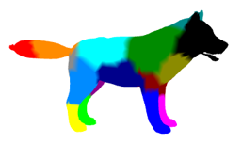
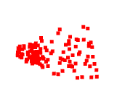
OptCtrlPoints Algorithm
Starting from K control points initialized by FPS, we iteratively select the $k_{th}$ control point and update it while keeping the other $K−1$ points.
First stage
Select $k_{th}$ control point
Fix $K−1$
Control Points
Choose
the best partition
Choose
the best point
within the partition
$K$ control points
initialized by FPS
The best $k_{th}$ control point
K partitions
Replace $k_{th}$ control point
Notes:
We iteratively refine a set of control points starting from an initial K control points initialized by FPS. When executing algorithm, we fix the other K minus one control points and only update k_th control point.
(enter)
Let me explain the first stage of OptCtrlPoints.

Slide 37
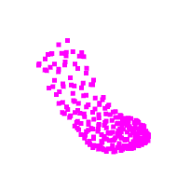
OptCtrlPoints Algorithm: First Stage
Identify the partitioned region for further exploration.
Error
0.073
Select random
& Calculate Error
0.065
Select random
& Calculate Error
Choose
the best partition
0.102
Partition $l$
$K$ partitions
Select random
& Calculate Error
…
Notes:
(enter)
In the first stage, we determine the partition to which the k-th control point will move.
(enter)
We select the one of the sampled vertices that provides the minimum sum of distances between the template mesh and all the target shapes after deformation when substituting the current k-th control point.
(enter)
By finding the vertex with the minimum sum of fitting distances, we identify the corresponding partitioned region for further exploration.

Slide 38
OptCtrlPoints Algorithm
After the first stage, we have the best partition $l$ among $K$ partitions.
Select $k_{th}$ control point
Second stage
Fix $K−1$
Control Points
Choose
the best partition
Choose
the best point
within the partition
$K$ control points
initialized by FPS
The best $k_{th}$ control point
K partitions
Replace $k_{th}$ control point
Notes:
After the first stage, we have the best partition $l$ among $K$ partitions.
(enter)
We can find the best k_th control point after the second stage.

Slide 39
OptCtrlPoints Algorithm: Second Stage
Find the best vertex that minimizes the fitting error within the selected partition.
Error
0.065
Calculate Error
0.061
Calculate Error
Choose
the best point
0.063
Partition $l$
Calculate Error
…
Notes:
In the second stage, within the selected region l,
(enter)
we find the best vertex, similar to the first stage.
(enter)
We calculate the fitting error when substituting the current k-th control point and select the one that minimizes the fitting error.
(enter)
The vertex selected during this step becomes the new k-th control point for the subsequent iteration.

Slide 40
OptCtrlPoints Algorithm
Iteratively select and replace the $k_{th}$ control point while fixing the others.
Whole algorithm $𝒪\left(N+K^{2}\right)≪$ Exhaustive search $𝒪\left(N^{K}\right)$
$K≪N$ (ex. $K=16, N=5,000$)
First stage $𝒪\left(K^{2}\right)$
Second stage $𝒪\left(N\right)$
Select $k_{th}$ control point
Fix $K−1$
Control Points
Choose
the best partition
Choose
the best point
within the partition
$K$ control points
initialized by FPS
The best $k_{th}$ control point
K partitions
Replace $k_{th}$ control point
Notes:
We iteratively refine a set of control points starting from an initial configuration along this algorithm.
(enter)
The time complexity of the first stage is O K square, since we search K partition K times.
(enter)
Assuming an even partitioning of the template mesh with an equal number of vertices in each region, the average time complexity of the second stage is O(N).
(enter)
When we run whole algorithm, the total time complexity is O N plus K square. Our algorithm significantly reduces the computation time compared to the exhaustive search complexity of O(N to the K).

Slide 41
Challenges
1. Long computation time of $W(S;A)$due to varying control points.
When control points vary, the calculation of $W\left(S;A\right)$ becomes a bottleneck.
→ We propose a reformulation of $W(S;A)$that reduces computation time.
2. NP-complete combinatorial optimization problem.
Exhaustive search $𝒪\left(N^{K}\right)$ is infeasible due to the high number of vertices.
→ We propose an efficient search algorithm $𝒪\left(N+K^{2}\right)$.
Notes:
So we address the first challenge with our reformulation, and the second challenge with our efficient search algorithm.

Slide 42
Results
Notes:
[12:40]
Now, I’ll explain the results.

Slide 43
Datasets
Parametric models for evaluation
SMPL [Loper et al., 2015]
SMAL [Zuffi et al., 2017]
Non-parametric model (real-world case)
DeformingThings4D [Li et al., 2021]
Notes:
For the experiment, we use three datasets containing a variety of characters. SMPL and SMAL are parametric models and used for evaluation and DeformingThings4D represents the real world case.

Slide 44
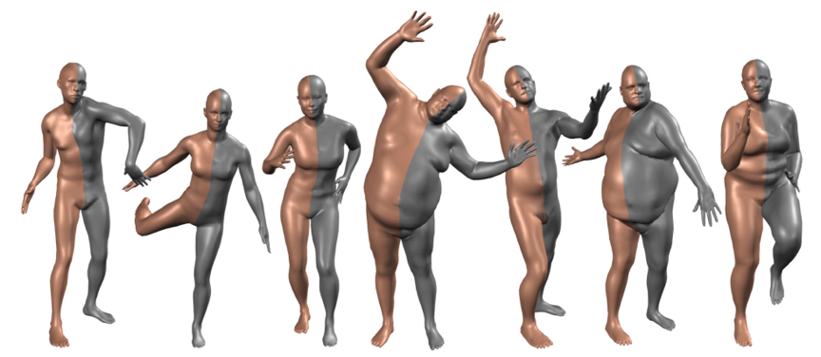
Dataset – SMPL
SMPL is a realistic 3D model of the human body that is based on skinning and blend shapes.
We randomly generate 1,000 target human shapes.
SMPL [Loper et al., 2015]
Notes:
For human models, we use synthetic shapes generated from SMPL.
SMPL is a realistic 3D model of the human body that is based on skinning and blend shapes.
We use the rest pose as the template shape and generate one thousand random target shapes with SMPL parameter.

Slide 45
Dataset – SMAL
SMAL is a 3D articulated model that can represent animals.
We randomly generate 1,000 target animal shapes per each category (fox, hippo, horse, and tiger).
SMAL [Zuffi et al., 2017]
Notes:
For animal models, we use four classes of shapes including fox, hippo, horse, and tiger generated from SMAL.
The SMAL model is a 3D articulated model that can represent animals which is inspired by the SMPL model.
We use the rest pose as the template shape and generate one thousand random target shapes with SMAL parameter for each template.

Slide 46
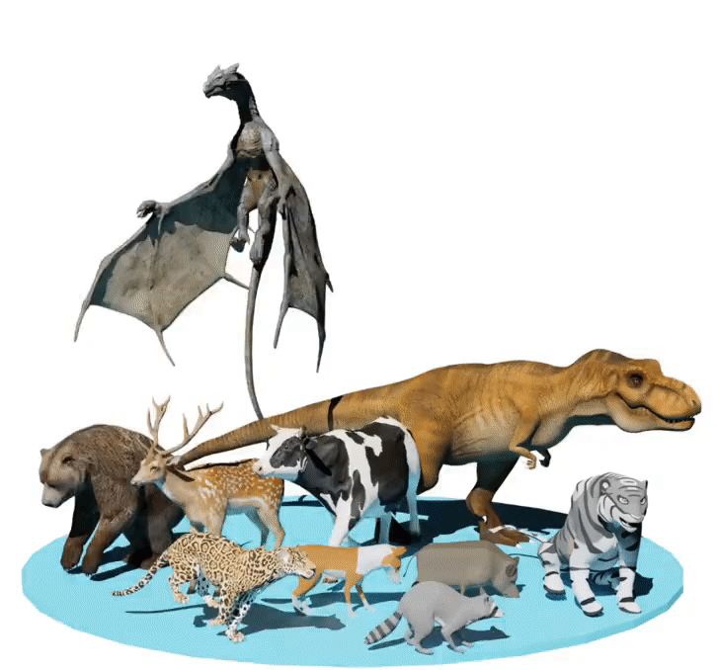
Dataset – DeformingThings4D
DeformingThings4D contains characters from Adobe Mixamo and also multiple animated motions for each character. We use 7 animal categories.
DeformingThings4D [Li et al., 2021]
Notes:
DeformingThings4D contains characters from Adobe Mixamo and also multiple animated motions for each character. We use seven animal categories in our experiments.

Slide 47
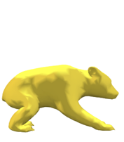
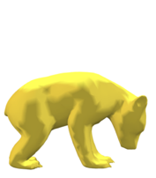
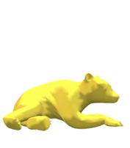
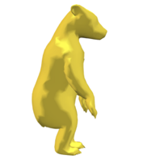
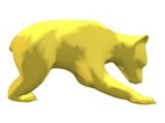
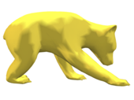
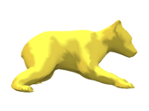
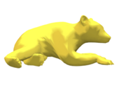
Dataset – DeformingThings4D
Two distinct experimental setups
(1) Per-category: Find the control points with a wide range of variations.
(2) Per-motion: Find the control points with a specific type of variations.
Randomly sample 1,000 different targets across all motions.
bear3EP_Hide1
bear3EP_Eat1
bear3EP_Lie
bear3EP_Agression
Use all the frames of the same motion as targets.
bear3EP_Lie
Notes:
To show the effectiveness of our data-driven manner, we present two distinct experimental setups: per-category and per-motion.
Per-category setup is used for finding the general control points since it involves a wide range of target variations.
Conversely, Per-motion setup is employed for finding the specific control points due to its smaller target variations.
(enter)
For the per-category experiments, we randomly sample one thousand different targets from all motions per each category.
(enter)
For the per-motion experiments, we use all the frames of the same motion as targets.

Slide 48
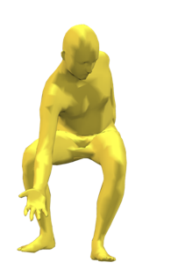
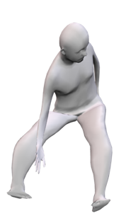
Evaluation Metric
Average L2 loss measures the average fitting error between a set of $M$ target shapes ${\left\{𝒳_{i}\right\}}_{i=1}^{M}$ and deformed templates ${\left\{V_{i}\right\}}_{i=1}^{M}$.
$$\frac{1}{M}\sum_{i=1}^{M}{{\left(𝒳_{i} −V_{i}\right)}^{2}}$$
Avg. L2 Loss =
Vertex-to-vertex error
Target $𝒳_{i}$
Deformed template $V_{i}$
Notes:
For the evaluation metric, we used average L2 loss that measures the fitting error between deformed templates and target shapes, since we aim to deform the template to match the target shape.

Slide 49
Baselines
FPS: Geodesic Farthest Point Sampling
Random search: $N × K$ steps.
KeyPointDeformer (KPD) [Jakab et al., 2021]: Trained with our data.
Notes:
To show the effectiveness of our proposed method, We compare our method, OPTCTRLPOINTS, with three different baselines.

Slide 50
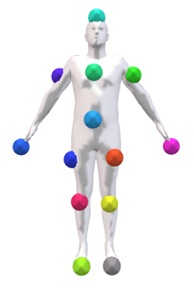
Baseline 1 – FPS
Geodesic Farthest Point Sampling (FPS) is our initial set of control points, as the final set without searching.
Notes:
FPS is the case of directly using the geodesic Farthest Point Sampling vertices, our initial set of control points, as the final set without searching.

Slide 51
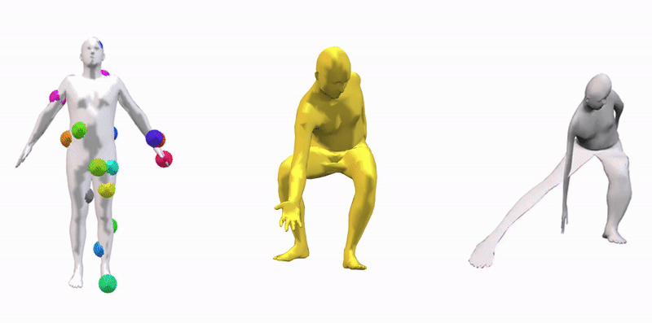
Baseline 2 – Random Search
Iterate the random set sampling process $N × K$ times, which is significantly larger than the number of iterations in our method.
Deformed
template
Template
Target
Notes:
Instead of the computationally infeasible exhaustive search that tests all possible subsets, we compare our method with a random search approach.
We iterate the random set sampling process N by K times, which is significantly larger than the number of iterations in our method.

Slide 52
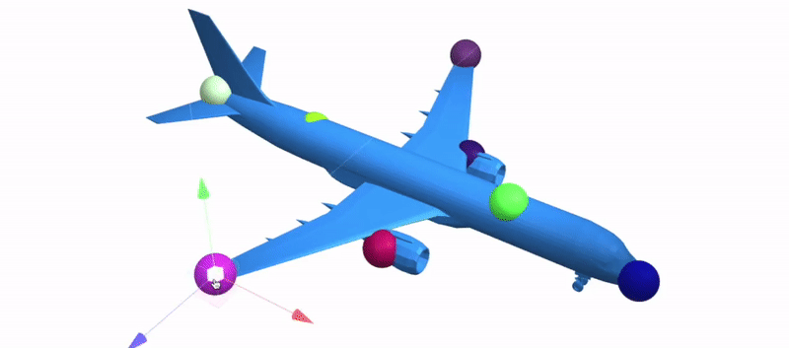
Baseline 3 – KeypointDeformer
KeypointDeformer is a neural-network-based approach to predict keypoints on shapes and align the template to the target through cage-based deformation.
KeypointDeformer [Jakab et al., 2021]
Notes:
We additionally compare our method with KeyPointDeformer, which leverages a neural-network-based approach to predict keypoints on shapes and align the template to the target through cage-based deformation.
For fair comparison, We trained KeyPointDeformer for each template shape and its corresponding set of targets using the released codebase.

Slide 53
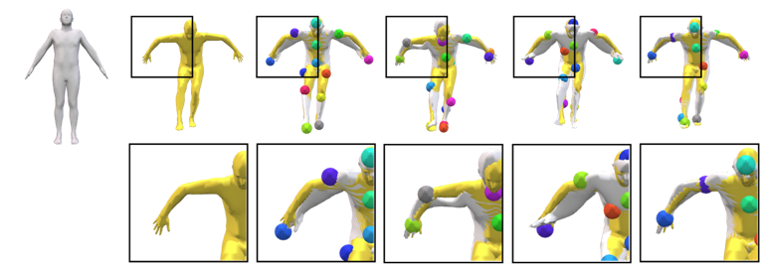
Fitting Error Comparisons with SMPL
White shape: the deformed template.
Yellow shape: the target shape.
Error map: vertex-to-vertex error between the deformed template and target shape.
Template
Target
FPS
Random
KPD
Ours
Deformed template
with target
0.01
Vertex-to-vertex
error map
0.001
Notes:
We show qualitative comparisons of our approach compared to FPS, random search and KeyPointDeformer, respectively.
For each example, a white shape denotes the deformed template, and a yellow shape denotes the target shape.
(enter)
We also show the raw output deformed source shape colored with vertex-to-vertex alignment to target error map for visualization.
(enter)
Notice that our approach finds better control points near joints as shown in the shoulder of the human and achieves better fitting error than other baselines.

Slide 54
Fitting Error Comparisons with SMAL
Template
Target
FPS
Random
KPD
Ours
0.01
0.001
Notes:
Compare to FPS, where our initial set of control points is used directly, our method demonstrates a significant improvement in the legs of the fox.

Slide 55
Fitting Error Comparisons with SMAL
Template
Target
FPS
Random
KPD
Ours
0.01
0.001
Notes:
Compare to Random search, our method can preserve details of hippo’s hip.

Slide 56
Fitting Error Comparisons with SMAL
Template
Target
FPS
Random
KPD
Ours
0.01
0.001
Notes:
Furthermore, compared to Keypointdeformer, which employs cage-based deformation instead of biharmonic deformation, our method excels in fitting the template to the targets through deformation.

Slide 57
Fitting Error Comparisons with SMAL
Template
Target
FPS
Random
KPD
Ours
0.01
0.001
Notes:
Notably, failure cases of FPS and random search are observed, the legs and body of the tiger deviates from the target shapes, while ours preserve fine details.

Slide 58
Fitting Error Comparisons with DeformingThings4D
Template
Target
FPS
Ours
Per-category
Ours
Per-motion
0.01
0.001
Notes:
In the experiment with the DeformThings4D dataset, we highlight the effectiveness of our OPTCTRLPOINTS in discovering the optimal set of control points for a given set of targets in a data-driven manner.
Our per-motion approach significantly outperforms the FPS baseline in scenarios involving larger motions and wider variations in the targets.

Slide 59
Fitting Error Comparisons with DeformingThings4D
Template
Target
FPS
Ours
Per-category
Ours
Per-motion
0.01
0.001
Notes:
Our method achieves much better results in recovering the geometry of the deer’s face and legs, whereas FPS falls short in this regard.
Since per-motion has smaller target variations than per-category, our method can find the more optimal control points in per-motion setup.

Slide 60
Fitting Error Evaluation of SMPL & SMAL
Average fitting distance (L2) between corresponding vertices of the target shapes and the deformed template shapes when $K=16$.
Average Fitting Distance $(×{10}^{−4})$
Methods | SMPL | SMAL
Keypoint Deformer | 17.09 | 25.72
FPS | 11.28 | 10.39
Random Search | 8.38 | 8.01
Ours | 5.16 | 4.79
Notes:
We conducted experiments with all methods with sixteen control points.
This table shows that our method reduces the fitting error drastically.

Slide 61
Computation Time Analysis
Execution time profiling of our OptCtrlPoints compared to the random search.
(Tested on NVIDIA RTX 3090 with PyTorch implementation, and $K=16$)
Methods | Time
Random Search w/o reformulation | 1.66 days
x49 faster
using our reformulation!
x854 faster
using our algorithm!
Random Search with reformulation | 48.8 mins
Ours with reformulation | 2.8 mins
Notes:
We also demonstrate the efficiency of our method compared to the naive random search approach for finding a better solution.
In random search, we sample subsets of vertices N by K times, so it takes day without our reformulation.
(enter)
With the reformulation, the computation time of random search is reduced by almost one hour, making it forty-nine times faster.
(enter)
Our search algorithm results in a significant reduction in computation time, decreasing it from about a day to approximately 3 minutes, while also obtaining a better set of control points as demonstrated in before.

Slide 62
Fitting Error Evaluation of DeformingThings4D
Per-motion setup achieves a lower fitting error compared to the per-category setup ($K=16$).
Average Fitting Distance $(×{10}^{−4})$
Methods | Per-category | Per-motion
FPS | 24.56 | 23.17
Random Search | 17.54 | 15.14
Ours | 11.04 | 9.61
Notes:
Our approach outperforms both FPS and random search in both the per-category and per-motion setups.
Notably, our OPTCTRLPOINTS consistently achieves a lower fitting error in the per-motion setup compared to the per-category setup.
This outcome is attributed to our data-driven approach, which enables us to discover control points that are tailored to the given set of targets.

Slide 63
Summary
Control points provide high flexibility, but it is challenging to find the best positions for control points that can generate plausible deformed shapes.
We introduced OptCtrlPoints, a data-driven method for determining the optimal set of control points to replicate target shapes as biharmonic deformations of the template mesh.
To address computational challenges, we introduce the reformulation of biharmonic weight that can solve a linear system on a much smaller scale.
We propose an efficient search algorithm that reduces the time complexity $𝒪\left(N^{K}\right) →𝒪\left(N+K^{2}\right)$.
Our algorithm significantly outperforms the random search in terms of both quality and time efficiency.
Notes:
In summary, control points provide high flexibility, but it is challenging to find the best positions of control points that can generate plausible deformed shapes.
(enter)
So, We introduced OptCtrlPoints, a data-driven method for determining the optimal set of control points to replicate target shapes as biharmonic deformations of the template mesh.
(enter)
To address the computational challenges, we first introduce the reformulation of biharmonic weight that can solve a linear system on a much smaller scale.
(enter)
And our efficient search algorithm reduces the time complexity from O N to the K to O N plus K square.
(enter)
We show that our algorithm significantly outperforms the random search in terms of both quality and time efficiency.

Slide 64
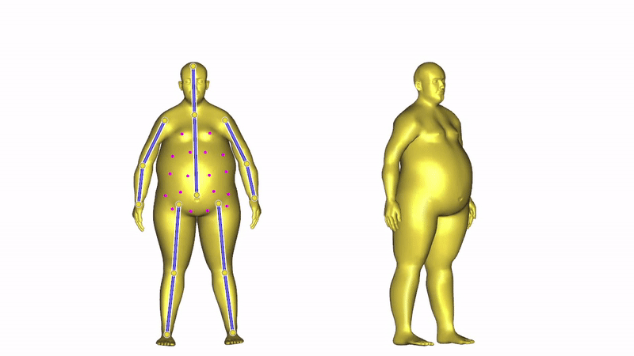
Future Works
Extend our method to find the optimal combinations of control point handles and region handles.
Linear Subspace Design for Real-Time Shape Deformation [Wang et al., 2015]
Notes:
In future work, we plan to extend our method to identify region handles of 3D shapes.

Slide 65
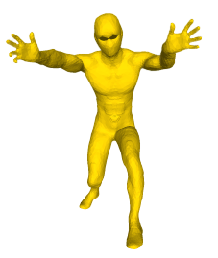
Future Works
Extend our method for heterogeneous template and target shapes.
Template
Target
Deformed
template
Notes:
In OptCtrlPoints, we assume that the correspondence between template and target shapes are given. We will further extend method if the template shape and target shapes are heterogenous.

Slide 66
Acknowledgements
NRF grant RS-2023-00209723
IITP grant RS-2023-00227592 (MSIT)
Technology Innovation Program 20016615 (MSIT)
ETRI
KT
NCSOFT
Samsung Electronics
ARL grant W911NF-21-2-0104
A Vannevar Bush Faculty Fellowship
Adobe
Snap
Swiss National Science Foundation under grant P500PT 206946
Notes:
We thank to all supports for our project.

Slide 67
Thank you
OptCtrlPoints: Finding the Optimal Control Points for Biharmonic 3D Shape Deformation
Kunho Kim, Mikaela Angelina Uy, Despoina Paschalidou, Alec Jacobson, Leonidas Guibas, Minhyuk Sung
Project page
Notes:
You can access our project page through this QR code. If you have any question on our project, please contact me.
Thank you for your attention.

